Slide 1
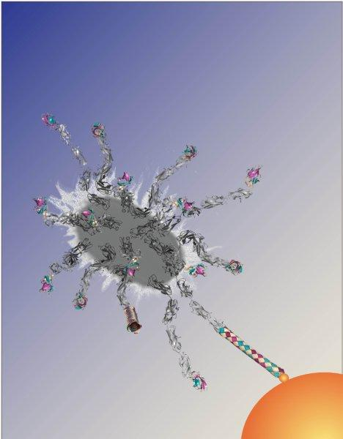
How the Thomas Lab Uses Mathematical Modeling: Validation vs Value Wendy Thomas Bioengineering, University of Washington Bioen 485 June 1, 2015

Slide 2
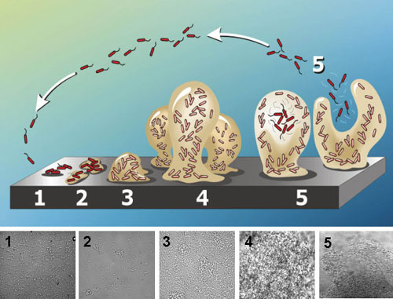
Why Study Bacterial Adhesion?
Learn to Block Adhesion to Prevent Infection
Adhesion is the first stage in Biofilm Formation
By blocking adhesion, can we prevent infections?
More specific than antibiotics
Bacteria can’t as easily develop resistance.
http://www2.binghamton.edu/biology/faculty/davies/research.htm
Bio-inspired Reversible Adhesive to Human Tissue
Minimally invasive surgery
Microrobotics and laproscopics must bind reversibly to move or grab.
Bacteria do this.
Can we learn from them?
Buselli et al Meas. Sci. Technol. 21 (2010) 105802

Slide 3
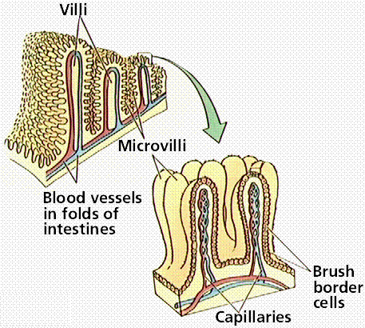
Why Study Adhesion in Flow?
Blood Cells
Pathogens and Commensals
nutrients
1 Pa = 10 dynes/cm²
Platelets and thrombosis
Leukocytes (white blood cells) and inflammation (infection, cancer, vascular disease)
Bacteria or viruses
Blood (0.01 – 5 Pa)
Intestines (> 1 Pa)
Urinary tract (< 0.5 Pa)
Blood cells and Bacteria must resist forces when binding

Slide 4
Why Use Computational Models?
Test mechanism for how bacterial feet grip
Understand how these mechanisms are important to cell adhesion
:
Fluid Flow
y
x
z
α
Test mechanism for how bacterial legs stretch
Use models for to design adhesive or anti-adhesive technology
models can test mechanisms at molecular and cellular scale
Notes:
Explain basic set up, 3D sphere resting on surface, end of fimbriae can form bonds with the surface, driven by laminar fluid flow.
Insert hookean spring and torsional symbols
Bell model rates depend exponentially on force
Gillespie to speed up sims

Slide 5
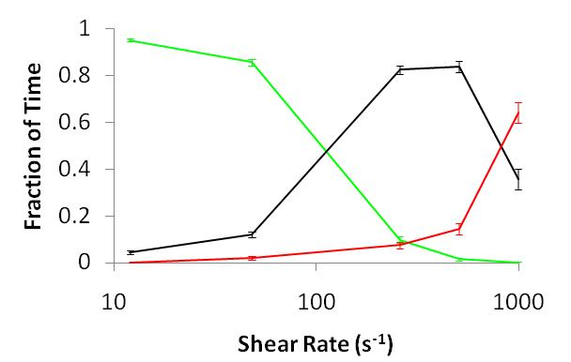


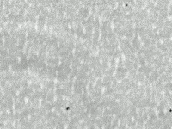
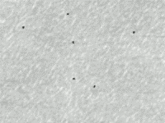
Study Bacterial Adhesion in Flow
rolling
stationary
Cell expressing receptors
Syringe
Pump
free
floating
PPFC
E. coli
mannose-BSA
Ligand-coated surface
0.01 0.1 1
Flow (Shear stress, Pa)
Low Flow (0.01 Pa)
Medium Flow 0.5 Pa
→High Flow 2 Pa
E. Coli Bugs Stick when the Going Gets Tough

Slide 6
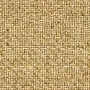
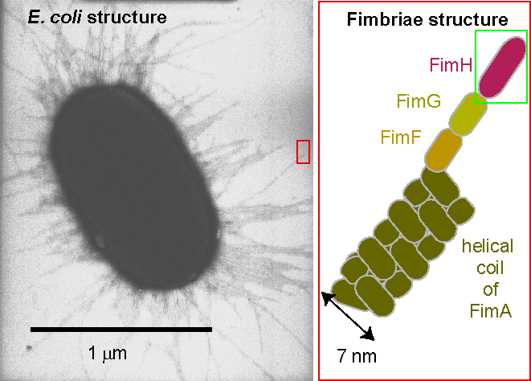
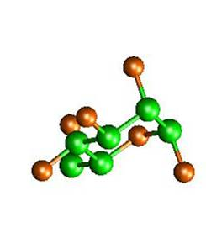
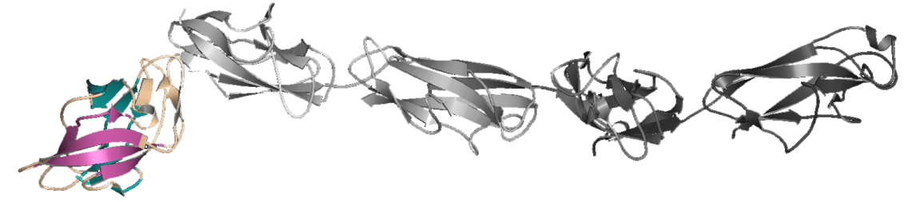
What Structures may Contribute to this Behavior?
Cell wall is rigid relative to long fimbriae that coat the bacteria
FimH adhesin (bacterial receptor) at tip of each fimbria.
50 nm
500 nm = ½ μm
glycoproteins on cells
90% of E. coli and other enteric bacteria have
type 1 pili
Tip receptor is called FimH and binds mannose
Tip structure:
Le Trong, J Struct Bio 2010
Notes:
These E. Coli, like most, are decorated with many long fimbriae.
At the tip of each is the adhesive protein, FimH
One domain of FimH integrates it into the fimbria, while the other is a lectin, or carbohydrate binding protein.
It binds specifically to mannose, a sugar that is on the tips of many glycoproteins expressed on many host cells.

Slide 7
Part I: Mechanistic Model of Bacterial Feet

Slide 8
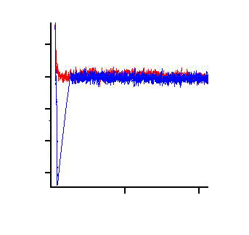
How We Measure Bond Mechanics
Atomic Force Microscope (AFM)
repulsion
(push)
photodiode
detector
laser light
50
0
-50
-100
-150
-200
-250
approach
Force, pN
retract
ligand-coated cantilever tip
(~ 20 nm across)
attraction
(pull)
rupture force
receptor coated surface
0 0.2
Separation, μm
Constant speed: measure rupture force
Method of single molecule force spectroscopy

Slide 9
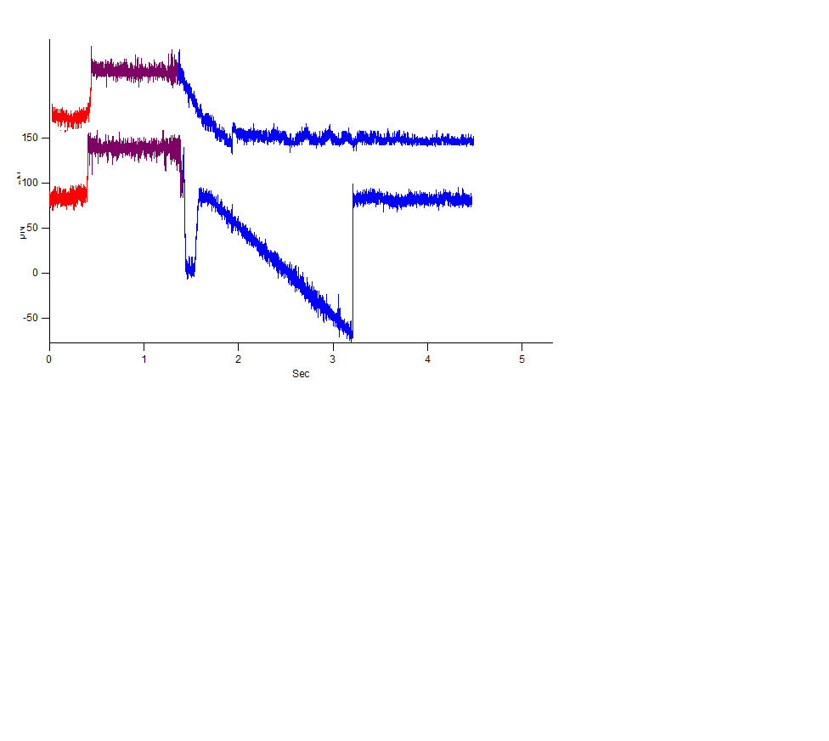
Mechanical Properties of FimH-mannose bond
Standard pulls
Mannose-BSA
FimH
press
Standard pull
100 -
50-
0-
-50-
-100-
-150-
force
80 pN pre-load
0 1 2 3 4
time, seconds
Yakovenko JCB 2008
Tensile force induces a much stronger state

Slide 10
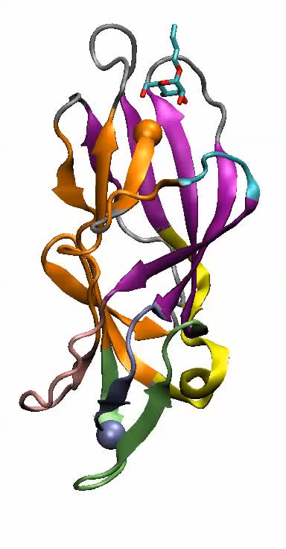
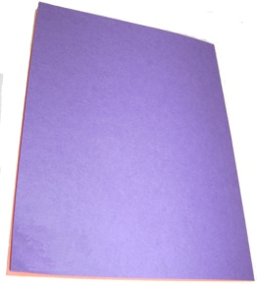
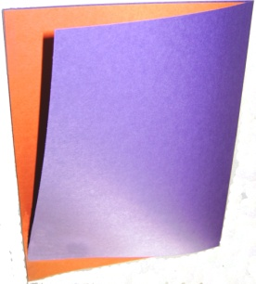
Structural Basis of FimH Catch Bonds
finger trap
β-sheet page turning
Mechanical Force switches state and causes FimH to Catch

Slide 11
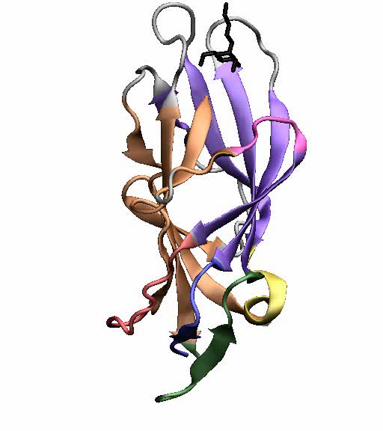
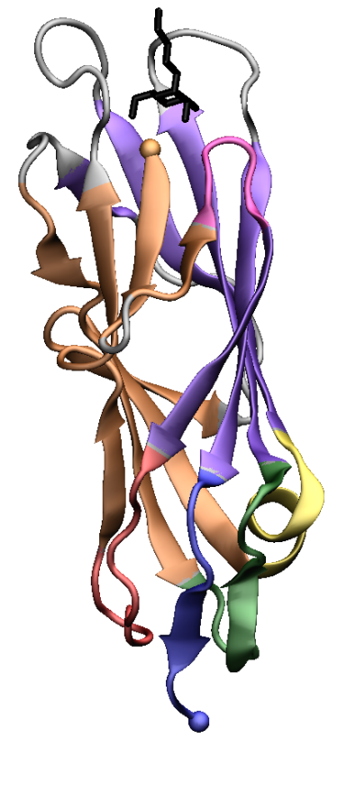
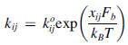
Quantitative Model for FimH Catch Bonds
Allosteric (2-state) catch bond model
no force
with force

Slide 12
Model Fits Data for FimH Catch Bonds:
(Increase force until Rupture)
Preliminary Validation: fit Allosteric Catch Bond Model to Wildtype FimH data
Advanced Validation: predict behavior of of Activated FimH
No new fit!
Models (dotted lines) fit data (solid symbols/lines) at 82, 820, & 8200 pN/sec
Conclude: Yakovenko 2008: FimH forms catch bonds that are enhanced by mechanical force due to allosteric regulation

Slide 13

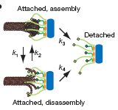
How Common are Catch Bonds?
Cell adhesive molecules
Intracellular bonds exposed to force
Bacterial adhesive molecules
Actin-myosin
E. coli
Guo (2006) PNAS
FimH/mannose
Yakovenko (2008) JBC
P-, L- and E-selectin
shear-enhanced bacterial adhesion:
E. Coli P-fimbria (Nilsson 2006) &
E. coli CFA/I (Tchesnokova 2010)
Pseudomonas aeruginosa (Lecuyer 2011)
Staphylococcus epidermidis (Weaver 2011)
Streptococcus gordonii (Ding 2010)
Marshall (2003) Nature
Sarangapani (2004) JBC
Snook (2010) CMB
GPIb/VWF
Yago (2008) J Clin Invest
Integrins
Kong (2009) J Cell Bio
Kinetochore-microtubule complex
Cadherins
Rakshit & Sivasankar (PBS)
Akiyoshi (2010) Nature

Slide 14
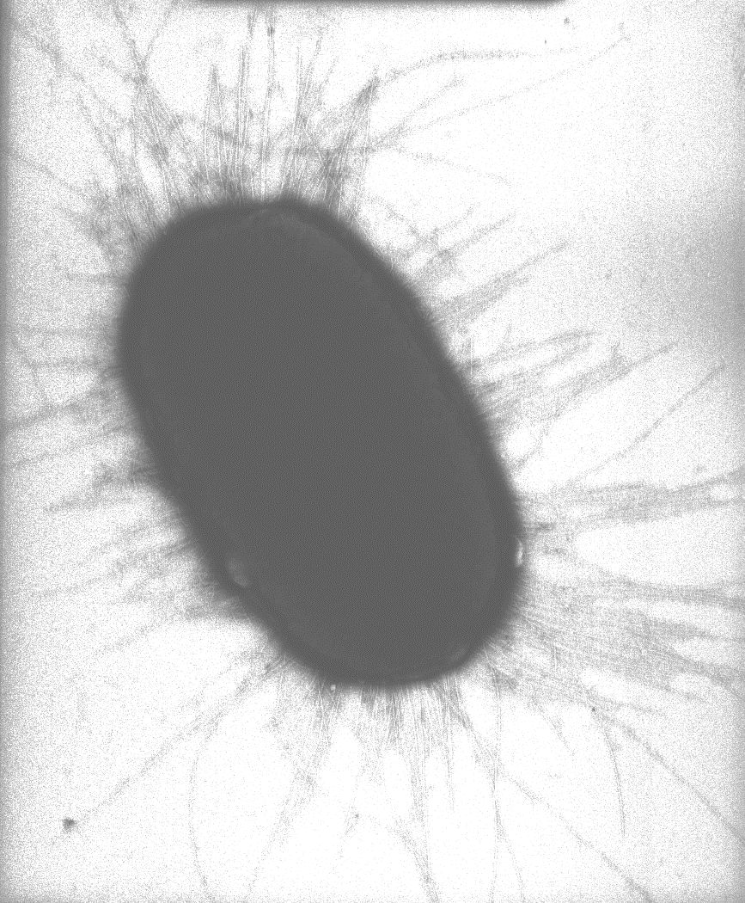
Part II: Mechanistic Model for Bacterial Legs

Slide 15
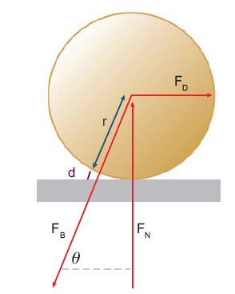
Why do we care about Tether Mechanics?
Estimate drag force on cell:
Estimate bond force for single bond:
Longer tethers reduce bond forces

Slide 16
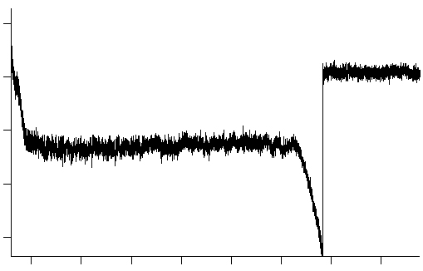
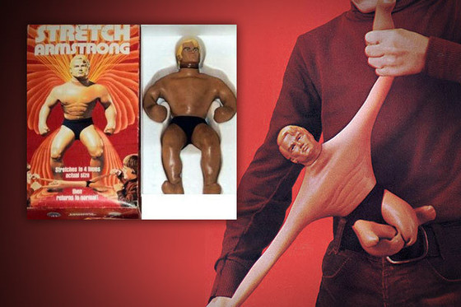
Mechanical Properties of Fimbrial Arms
Stretch Single Fimbriae
FimA subunit
Mannosylated cantilever tip
E.coli
Coiled
Uncoiled
E. Coli on surface
Uncoiling
Force
Tip detaches
This is called Yielding Elasticity
Fimbrial extension
Yielding is not as well understood as strain hardening and linear elasticity
linear elasticity
yielding elasticity
Strain hardening elasticity
Forero 2006 PLoS Biology;
Whitfield 2014 PLoS Comp Bio

Slide 17
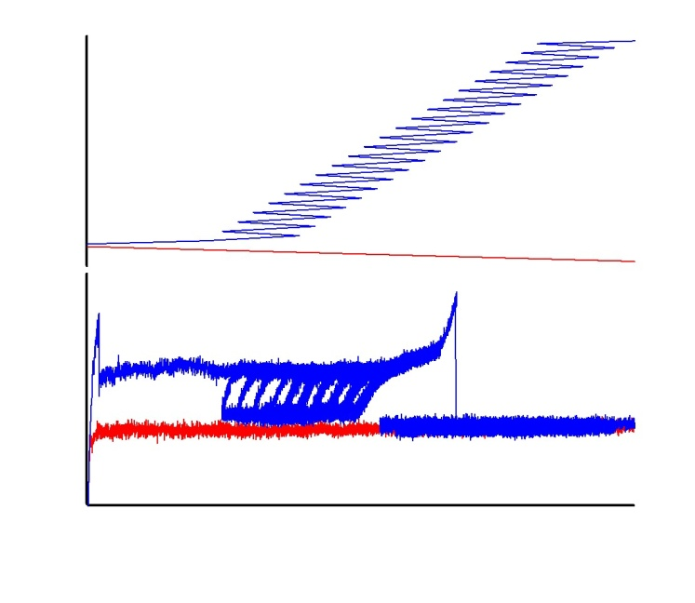
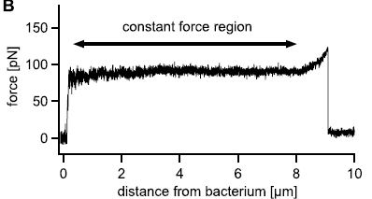
Probing Kinetics of Fimbrial Elasticity
Probing kinetics of phase transitions at various forces
hysteresis
Zig-zag
No hysteresis
position
time
Flat plateau with hysteresis
sloped plateau at equilibrium
Whitfield in preparation

Slide 18
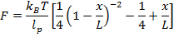
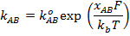
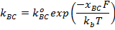
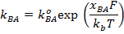
Quantitative Model of Fimbrial Elasticity
Worm-like chain = entropic spring;
F → ∞ as x → L
Hookean Spring
Stiffer Worm-like-chain
Softer Worm-like-chain
A
B
C
uncoiling
overstretching
Flat plateau ➔ cooperative behavior
Hysteresis ➔ slow kinetics
Sloped plateau ➔ Independent events
No hysteresis ➔ fast equilibrium

Slide 19
Quantitative Model of Fimbrial Elasticity
Lines: Simulated uncoiling
Symbols: Experimental data
Where FimH bonds are longest lived
8-parameter Model
Based on Known Biophysics Mechanisms.
Validated by fitting to data.
Weak validation for mechanism, but good fit to complicated data is enough to incorporate into larger model.

Slide 20
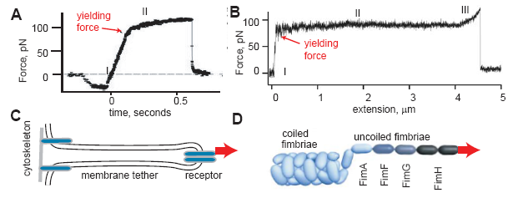
Yielding Tethers are Common
Membrane tethers
Bacterial fimbriae
Thomas, W. (2008). "Catch bonds in adhesion." Annu Rev Biomed Eng 10: 39-57
Alpha helix proteins in cytoskeletal spectrin, vimentin also uncoil and yield elastically
These anchor cadherins and integrins, which form catch bonds
Polymers of unfolding domains (fibronectin, fibrinogen, VWF) also yield elastically
They are common in extracellular matrix proteins to which cells bind
Yielding tethers have evolved in prokaryotes and eukaryotes

Slide 21
Part III: Mechanistic Model of Bacterial Adhesion

Slide 22
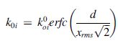
Adhesive Dynamics Simulations:
All but 2 parameters are independently determined
formation and breakage from weak state are fit.
:
Bond association proportional to probability of surface contact based on elastic properties and thermal energy (to get x_{rms}):
Fluid Flow
y
x
Bond dissociation according to the Allosteric catch bond model
z
α
Fimbrial behavior according to the fimbrial uncoiling model
Fimbrial length and number and bacterial size determined from electron micrographs
Whitfield Biophys J, 2010, and Whitfield in preparation
Notes:
Explain basic set up, 3D sphere resting on surface, end of fimbriae can form bonds with the surface, driven by laminar fluid flow.
Insert hookean spring and torsional symbols
Bell model rates depend exponentially on force
Gillespie to speed up sims

Slide 23
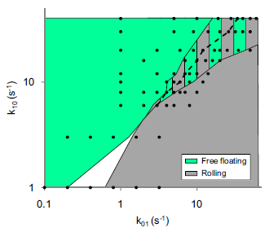
Fit Two Unknown Parameters
kon and koff were too fast to measure in our experiments, so we vary them to match the shear-dependent switch from free floating to rolling
Many values worked, as long as they are balanced and fast.
Free floating at low flow
Rolling at high flow
off-rate
on-rate

Slide 24
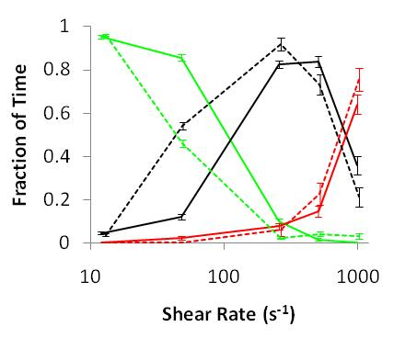
Validate Simulations
Quantitatively compare simulations to experiments:
free
floating
rolling
stationary
Experimental
Simulation
Moderate to Strong Validation:
Complex data matched with only 2 unknowns
new prediction, but data was already known to us

Slide 25
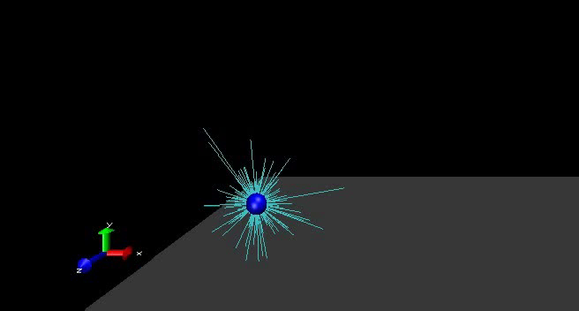
Behavior of Bacteria at Low Shear (0.01 Pa)
Analyze what you can’t see in experiments:
Green spheres = low affinity bond formed
Bacteria float freely at low flow because few fimbriae touch the surface and most bonds are low-affinity

Slide 26

Behavior of Bacteria at Medium Shear (0.25 Pa)
Buckled fimbriae = yellow. Bent fimbriae = angled
Bending and buckling causes stable rolling adhesion

Slide 27

Behavior of Bacteria at High Shear (1 Pa)
Red = high affinity state 2 bond
Bacteria are stationary when catch bonds activate

Slide 28
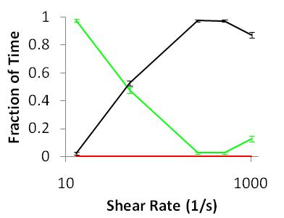
Learn Something New: Effect of Catch Bonds
Change what you can’t change in experiments: make weak slip bonds
Analyze what you can’t see in experiments:
Simulate catch bonds
Simulate slip bonds
Free floating
Free floating
Rolling
stationary
Rolling
fraction time
No stationary
Shear Rate (1/s)
Shear Rate (1/s)
Catch Bonds Cause Switch from Rolling to Stationary
Changed conditions we could not change in expts
Analyzed bonds states like we could not in expts.
Whitfield, et al Biophysical J (2010):
Notes:
Why do we want rolling without cbs?
Although the transition to the high-affinity state is force-enhanced, we do not believe it is involved in the shear-enhanced rolling. So we asked…

Slide 29
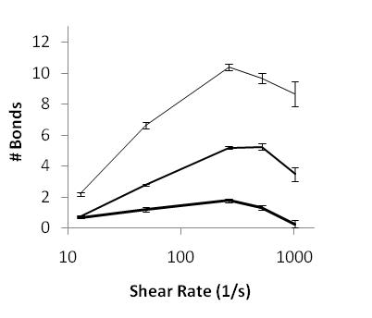
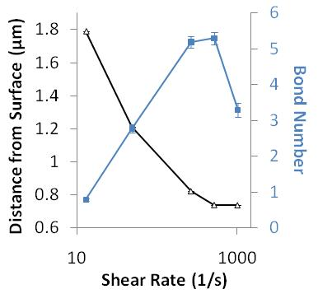
Learn Something New: Effect of Fimbrial Elasticity
Analyze what you can’t see in experiments:
Change things you can’t change in experiments:
5x Softer: always roll
Wildtype: roll only above threshold
# of bonds
μm from bacteria to surface
# of bonds
5x Stiffer: never roll
Shear Rate (1/s)
Shear Rate (1/s)
What allows rolling adhesion above a threshold?
More bonds form
Requires correct fimbrial elasticity
Notes:
Why do we want rolling without cbs?
Although the transition to the high-affinity state is force-enhanced, we do not believe it is involved in the shear-enhanced rolling. So we asked…

Slide 30
Validate Simulations at very high Shear:
Validate simulations
Experiments
Simulations
Bacteria creep forward but remain bound as flow is increased

Slide 31
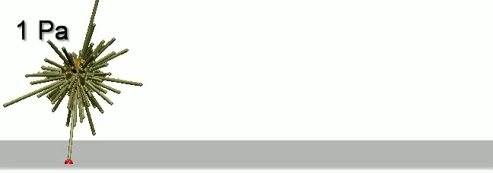
Learn Something New: Fimbriae Stretch
see what you can’t see in experiments:
Bacteria creep forward as fimbriae stretch
As shear stress increases, more catch bonds are activated (red).
When flow is turned down, bacteria moves backwards, activating bonds on the other side.

Slide 32
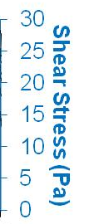
Learn Something New:
analyze things you can’t see in experiments:
As flow increases, more bonds activate but force per bond is the same at 50 pN.
If flow is turned off, more bonds activate and force per bond is still 30 pN.

Slide 33
Learn Something New: Effect of Yielding
Change things you can’t change in experiments:
linear elasticity
yielding elasticity
Strain hardening elasticity
Is Elastic yielding important?
Or is any kind of stretching enough?

Slide 34
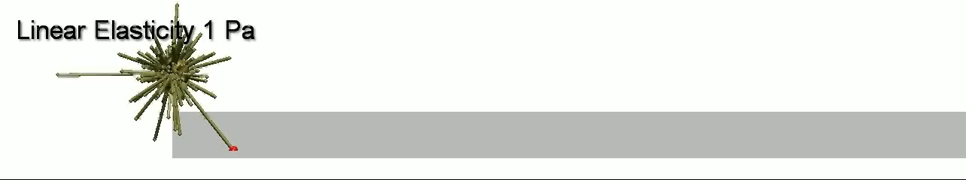
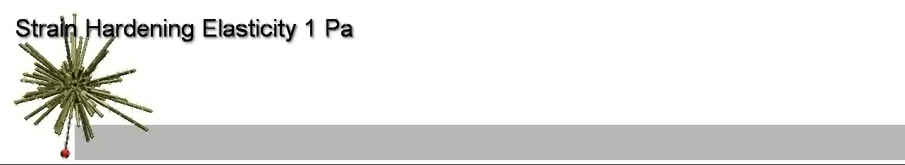
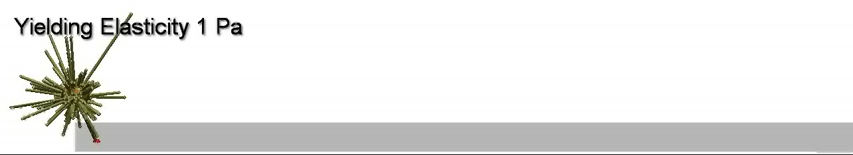
Simulations Show Importance of Elastic Yielding
Only yielding elasticity allows bacteria to remain bound

Slide 35
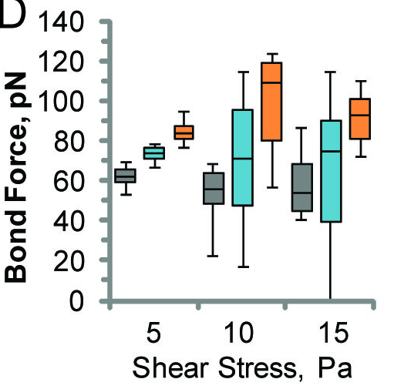
How Bacteria Resist Very High Shear
…and see things you can’t see in experiments:
How much force on each bond?
bonds are stretched to different lengths
The red zone: bonds break fast above 80 pN.
linear elasticity
yielding elasticity
Strain hardening elasticity
Yielding elasticity distributes force equally between multiple bonds, keeping bonds out of the red zone.
Elastic yielding distributes force equally over many fimbriae

Slide 36
Yet More Validation...
E. coli detach at low flow…
unless it is preceded by very high flow
Validation: predict new situation, no new fitting
Experiments (previous PNAS paper)
New Simulations
Robust adhesion in variable is critical with peristalsis..

Slide 37
CONCLUSIONS: How we used Models:
Validation: What made models convincing
Did not fit all parameters to complex behavior; instead, fit many parameters using other data (e.g AFM data of catch bonds, fimbrial stretching and EM images of bacteria). Also makes parameter estimation simpler!
Fit remaining parameters to match limited whole cell data
Used model repeatedly to predict new types of data not used in the fit, or even developed for this validation.
Methods: How did we learn new things? (value)
Analyzed things we couldn’t see in experiments
Changed conditions we couldn’t change in experiments
Value: what we learned: Mostly tested Hypotheses
FimH forms catch bonds that are enhanced by mechanical force due to allosteric regulation
Dynamic properties of fimbriae are consistent with a previously proposed biophysical model for uncoiling.
Catch bonds cause the switch to stationary adhesion in bacteria.
Fimbrial bending causes the switch from free floating to rolling adhesion.
Elastic Yielding helps bacteria stay bound at high flow by distributing force between bonds.

Slide 38
In your final projects
Match the level of certainty of the words you use to describe your results to the quality of your validation and verification.
Describe the model results with high certainty if your verification is successful.
Describe what the model tells you about the real system with high certainty only if validation is strong.

Slide 39
Verification, Validation, Level of Certainty
Is consistent with
May suggest
Suggests
Strongly suggests
Indicates, shows, demonstrates, direct statement w/o qualification
Proves (only use for math proof)
Level of certainty of model results reflects quality of verification
Level of certainty of statement about real system also reflects quality of validation
Good validation adds to verification (less likely to fit data if math is wrong).

Slide 40

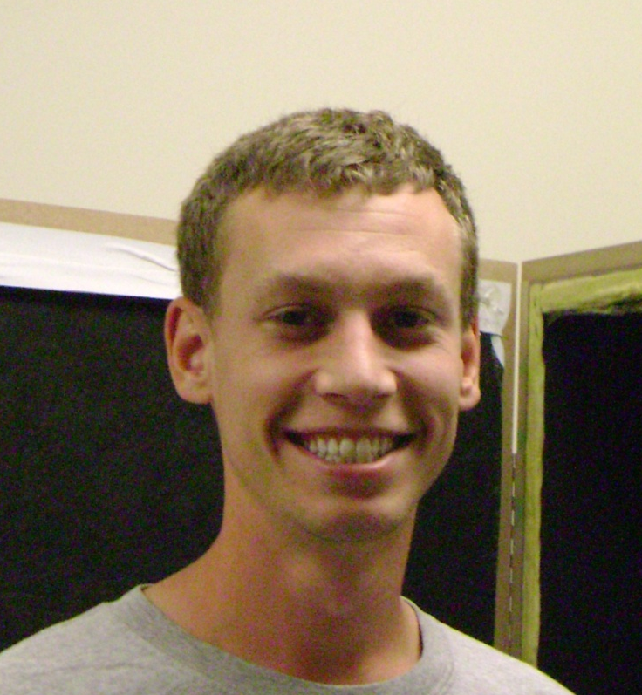
Acknowledgements
My Group:
Olga Yakovenko
Matt Whitfield
Tia Ghose
Keith Johnson
Victoria Rodriguez
Kimberly Tran
Jonathon Luo
Suron Woods (REU)
Colleagues:
Helpful Discussions:
Herbert Hui, Cornell
Nate Sniadecki, UW
Sachin Goyal, Cornell
Funding
NIH BRP grant
NSF CAREER Award
American Heart Association
University of Washington
Center for Nanotechnology UIF, IGERT
Molecular Biophysics Training Grant
Whitaker Foundation
Notes:
This work was done in the laboratory of my thesis advisor, Dr Viola Vogel in the department of bioengineering at the univeristy of washington and in collaboration with Dr. Sokurenko in the microbiology department.
I want to acknowledge Elena Trintchina, who did the mutagenesis in the sokurenko lab
Manu Forero who helped with the initial red blood cells assays and did the cell free bead assays in the vogel lab.
Lina Foreor who helped with the bacteria flow chamber assays and did some great inhibitor experiments.
Andre Krammer and David Craig who led the fibronectin SMD research in collaboration with KlausSchulten and UIUC

Slide 41
Milestone Value Added, due June 1, 2015.
What new knowledge can you learn from analyzing the model, and why might that new knowledge be important?
Consider the following:
What analysis will you do?
How is this knowledge more useful than that you have or can obtain through the experiments needed to validate the model enough to trust the knowledge?
How does this knowledge address different questions from the previous publications that are most related to your project?

Slide 42
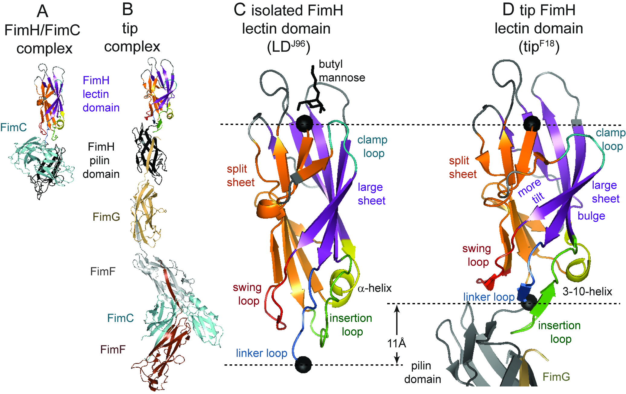
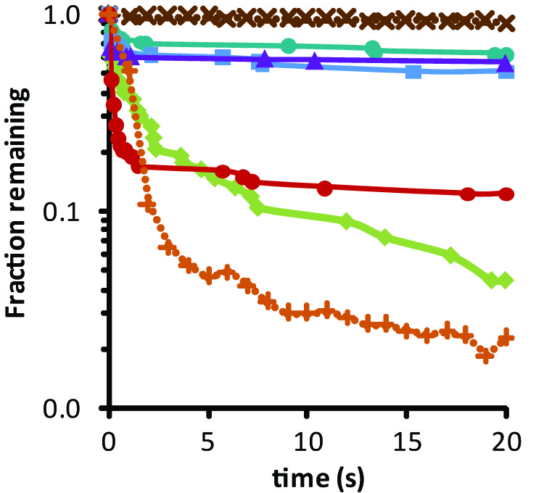
Bond Lifetime at Constant Force
Binding domain No force (SPR)
Tip 30-70 pN
Tip 20 pN
Tip 90 pN
Le Trong Cell 2010
Whole tip, No force (SPR)
Bonds are longer lived at higher force = ‘Catch Bonds’
High-force bond has similar lifetime as isolated binding domain
Low force bond has similar lifetime as full-length FimH

Slide 43
Computational Issue: How is force transmitted to these force sensors?
Need modeling methods that:
Span lengths scales – nanoscale to microscale
Spans time scales: time step fast vs slow relative to relaxation rates
Address stochastic jump processes (state changes)
Address stochastic diffusion processes
Handles objects that can be polymers, particles, surfaces, etc
Need to handle fluids? (CFD?)
Need to handle FEM of some objects?

Slide 44
When Diffusion dominates
At low Reynold’s numbers, diffusion dominates over inertia
True for small length scales and longer times
Forces still apply, giving deterministic portion of the equation.
But the velocity and thus momentum of particles does not need to be considered.
Weiner process

Slide 45
When Inertia Dominates
deterministic equation of motion must take into account both current position (r) and velocity (v). The external forces are taken into account with the acceleration (a).

Slide 46
Complex Systems:
Even at Low Reynold’s numbers, at small enough times, intertia has an effect
For any given time scale,
large particles have inertia-dominated behavior
small particles have diffusion-dominated behavior
So what algorithm can you use?
Need one that is accurate at both extremes, and in between.

Slide 47
Ermak Monte Carlo Simulations:
These simulations recognize that each particle continues to move deterministically in the same direction for short time periods, but are bombarded with other particles at longer time scales until their motions become uncorrelated.
The relaxation rate, ξ, at which this occurs is the ratio of the drag coefficient, γ, to the mass m:
ξ = γ / m.
To span these time scales, the position r and velocity v for each degree of freedom is calculated by both deterministic forces (acceleration) and thermal forces (drag and diffusion)

Slide 48
“Allen and Tildesley*” Ermak Monte Carlo Technique
Add drag and diffusion to 2nd order ODE:
where c₀, c₁, and c₂ are “frictional coeficents” that reflect ξ, thus drag.
and Δr_{L} and Δv_{L} are stochastic terms that reflect diffusion
* “computer simulations of liquids” by Allen and Tildesley © 1987

Slide 49
The Frictional Coefficients:
The frictional coefficients are:
The stochastic terms, (Δr_{L} and Δv_{L}) are sampled from a bivariate Gaussian distribution with zero mean, and variance:
approaches Weinger process of diffusion dominated situation
approaches Inertia dominated situation

Slide 50
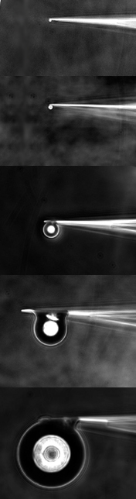
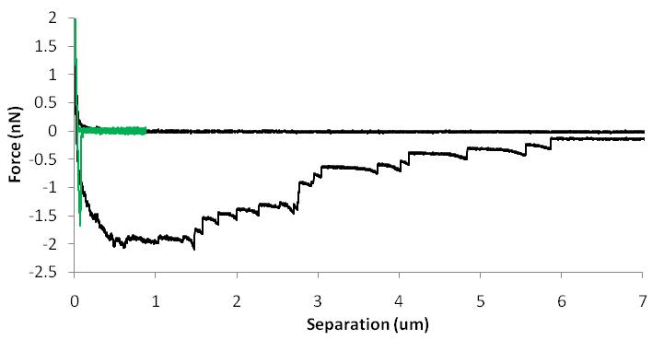
Significance to Adhesive Technology:
Bioinspired Adhesion: can we learn from bacteria how to make strongly reversible adhesive to human tissue?
Microscale adhesion against applied force:
As expected, work of adhesion is higher with elastic fimbriae.
Elastic energy contributes to work
mannose
Just FimH in fimbrial tips
Fimbriae with FimH
Negative control

Slide 51
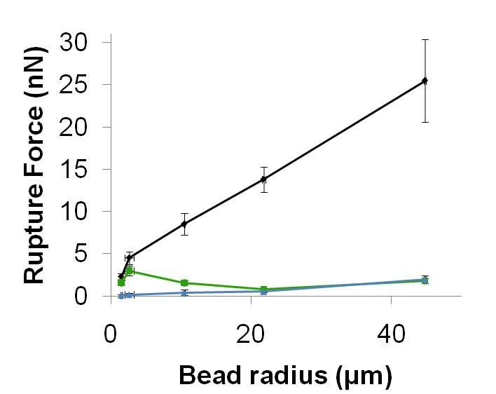
Fimbriae are Needed for Microscale Adhesion
Maximum rupture force
1.5 µm
just FimH
fimbriae
neither
Is this due to fimbrial bending or uncoiling? Can’t separate the two experimentally
45 µm

Slide 52
FimH Adhesive is Reversible and Self Cleaning
Reversible
Self-cleaning
Do these properties depend on catch bonds or fimbrial bending or uncoiling? Again, easy to test in simulations
Notes:
Many promising aspects
Also increased lifetime

Slide 53
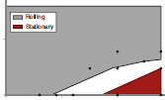

Cause of Rolling to Stationary Switch
Eliminating Catch bonds eliminates stationary adhesion
stationary
slip bonds
catch bonds
Bound
fraction time
fraction time
stationary
k₀₁
k₁₀
Unbound
Shear Rate (1/s)
Shear Rate (1/s)
Optimizing slip bond parameters can’t recover the effect
Rolling
Stationary
Mostly rolling at medium shear
Mostly stationary at high shear
Experimental
Distance traveled (μm)
Slip bond Simulation
k10 (off) in s-1
1 10
0.1 1 10
k01 (on) in s-1
Time (s)
“Sticking” of stick & roll adhesion requires catch bonds
Notes:
Add legend

Slide 54
Do Simulations Match Experiments?
Simulations Reproduce Stick & Roll Adhesion
Experimental
Simulation
free
floating
Identifying the two unknown parameters
rolling
stationary
Free floating
off-rate
Rolling
on-rate
Balanced on- and off-rates from weak state required to reproduce switch from free-floating to rolling adhesion

Slide 55
Shear Enhanced Adhesion is Common and has Many Potential Advantages
Leukocytes (L-selectin/PSGL-1)
binding to endothelial cells, patrol blood vessel walls, maintaining a fairly uniform velocity
Platelets (GPIb/VWF):
Shear enhanced adhesion allows specificity for arterial, not veinous thrombosis.
Mutations that lose this behavior cause disease
E. coli (FimH/Mannose)
Stick in high shear regions, where nutrients are rich
Can move when safe, but stick securely when not.
Mutations cause commensal bacterial to be pathogenic.
E. coli (P-pili, CFA/ligands).
S. Gordonii (GspB/sTa)
Staph. aureus (Collagen)
Loss of Shear Enhanced Adhesion Causes Disease

Slide 56
Mechanisms of Shear Enhanced Adhesion
increase transport of bacteria to surface?
E. coli
increase rate of first bond formation once bacteria are near the surface?
E. coli
Does shear stress increase rate that additional bonds form?
E. coli
E. coli
E. coli
Does tension
increase bond lifetime?

Slide 57




What is Reversible Adhesion?
Damages surfaces if detached
irreversible
Safely removable
reversible
Unbinds & rebinds >10X
highly reversible
Reversibility
Smart Adhesive;
Self-cleaning
Strongly reversible
Notes:
Our objective is to understand mechanism of shear enhanced adhesion

Slide 58
BioCatch Adhesive: Strong and Reversible
Strong receptor-ligand bonds:
tear or damage tissue when detaching
easily fouled by soluble inhibitors or by torn-off surface receptors
catch-bond adhesion:
reversible without damage.
nonfouling:
releases ligand when force is removed
FimH: binds to all human tissues
“BioCatch” adhesive

